Slide 1

Security Awareness Training
Alpha Coding Ignite {ACI}
Presented by : Hajar Bouchriha

Slide 2



Agenda
To help employees identifying the informtion that must be protected the common threats against data information systems
The best practices and policies to safeguard information and information system’s confidentiality, integrity, and availability
Training to help users recognize and report cybersecurity incidents

Slide 3

What is Information Security?
Protects the confidentiality, integrity, and availability of important data
Controls can be Physical or Technical
Locks and safes – encryption and passwords
Technology has made our lives easier in many ways, but this convenience has also increased our exposure to threats
Thieves and attackers can also work more effectively

Slide 4
Why Should I Care?
Theft is becoming increasingly digital
Ease of identity, account, and credential theft makes everyone an ideal target
Applies to organizations that house such data or individuals themselves
Compromise may affect customers, coworkers, friends, and family

Slide 5
Historical Perspective
Many historical methods of monetary theft
Stagecoach Robberies
Train Hijacking
Armed Assault
“Inside Jobs”
Losses from tens of thousands of dollars, up into the millions
Today, most banks do not house “millions of dollars” on-premises
Liquid economy
Data is the new commodity
In 2006 there were 7,272 “robberies” totaling over $72,687,678

Slide 6
Statistics
$239.1 million (2007)
Total dollar loss from all referred cases of fraud
Increased from $198.4 million in 2006
Male complainants reported greater loss than females
Highest dollar losses were found among investment and check fraud victims
Email and web pages still primary mechanisms by how the fraudulent action happened
*Federal Bureau of Investigation Internet Crime Complaint Center - Crime Report for 2007

Slide 7
Modern Threats
Viruses, Trojans, Worms, and Root Kits
Adware/Spyware
Spam, Phishing, and other Email attacks
Identity Theft
Social Engineering

Slide 8
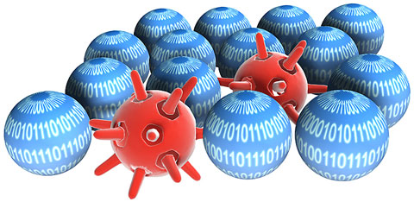
Viruses
Viruses are malicious programs that hide themselves on your computer
Usually very small
May have access to view or delete your information
Often contracted through a website, email, or p2p applications
May destroy your documents, format your hard drive, send emails from your computer or a variety of other nefarious actions – it just depends on the strain!
Viruses are created for the sole purpose of causing trouble
Taking revenge, political statements, etc…
Most modern viruses are financially motivated – may hold data for ransom or steal information
Just like real viruses, computer viruses spread to others…
Other computers on the network
Sending out email replications of itself
Always use anti-virus protection!
Famous viruses:
Love Bug
Code Red

Slide 9
Worms, Trojans, and Root Kits
Trojan appears as a legitimate program
Possible to repackage Trojans with legitimate programs
Worms are self-replicating
Typically propagate through un-patched systems
Blaster
Sasser
Root Kits
Low level programs that embed themselves in the operating system itself
Difficult if not impossible to detect

Slide 10
Adware/Spyware
Some malware is designed to solicit you, or gather information about your computing habits
Which websites you visit?
When? What times?
What are you purchasing?
How long do spend surfing the website?
How or what do you use your computer for?
Example: Sony “Root Kit”
Intended for “Marketing Purposes”
Commonly installed with p2p or free software
May be only an annoyance and cause no harm
What else may be installed alongside adware?

Slide 11
Email
Common Attacks
Phishing
Malicious attachments
Hoaxes
Spam
Scams (offers too good to be true)
Best Practices
Don’t open suspicious attachments
Don’t follow links
Don’t attempt to “unsubscribe”

Slide 12
Phishing
Deceptive emails to get users to click on malicious links
Enter sensitive information
Run applications
Look identical to legitimate emails
Your Bank
PayPal
Government
Variants
Vishing – same concept but with voice
User instructed to call into system
Text messages and postal mail

Slide 13
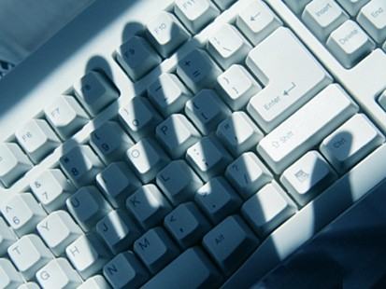
Passwords
Authentication is the first line of defense against bad guys
Logins and passwords authenticate you to the system you wish to access
Never share your password with others!
If someone using your login credentials does something illegal or inappropriate, you will be held responsible
The stronger the password, the less likely it will be cracked
Cracking: Using computers to guess the password through “brute-force” methods or by going through entire dictionary lists to guess the password
Strong passwords should be:
A minimum of 8 characters in length
Include numbers, symbols, upper and lowercase letters (!,1,a,B)
Not include personal information, such as your name, previously used passwords, anniversary dates, pet names, or credit-union related words
Examples:
Strong Password: H81h@x0rZ
Weak Password: jack1
Pass Phrase: 33PurpleDoves@Home? - Long, complex, easy to recall

Slide 14
Encryption
Encryption allows confidential or sensitive data to be scrambled when stored on media or transmitted over public networks (such as the Internet)
Many services, such as web and email, use unencrypted protocols by default
Your messages can be read by anyone who intercepts the message
For example, think of shouting a secret to one person in a crowded room of people
Always use encryption when storing or transferring confidential material
For Business use - Ask IT for assistance with encryption
For Personal use - Free programs, such as TrueCrypt, allow you to encrypt hard drives, flash drives, CompactFlash/SD cards and more
When purchasing online or using online banking, ensure that you are using an encrypted connection
Secure URLs begin with HTTPS://
Most browsers notify you that you are entering an encrypted transmission – be very cautious of warnings!
Padlock in bottom, right-hand corner of browser

Slide 15
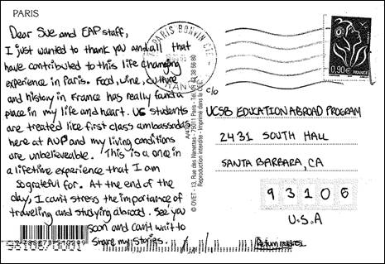

Looks Like Greek to Me!
Unencrypted Message Encrypted Message

Slide 16
Digital Threats: Protect Yourself
Never disable anti-virus programs or your firewall
This causes a lapse in security
Never download documents or files without the express permission of a supervisor, or unless otherwise stated in IT Policies
Could contain malware/spyware, viruses, or Trojans
Don’t open unexpected email attachments
Make sure it’s a file you were expecting and from someone you know
Never share login or password information
Anyone with your credentials can masquerade as you!
Do not ever send confidential information or customer data over unencrypted channels
Email
Instant Messaging
If you suspect you have been a victim of fraud, theft, or a hacking attempt, notify the IT Department immediately!
Notes:
Ask yourself – do I trust who this message is from?

Slide 17
Social Engineering
People are often the weakest links
All the technical controls in the world are worthless if you share your password or hold the door open
Attempts to gain
Confidential information or credentials
Access to sensitive areas or equipment
Can take many forms
In person
Email
Phone
Postal Mail

Slide 18
Remote Social Engineering
Often takes place over the phone
Attempts to gain information that may help stage further attacks
May pose as technical support, telephone company, or a vendor
Usually requests sensitive information
Login credentials or account information
Employee names and methods of contact
Information about computer systems
If you are unsure, or something seems suspicious, always verify by calling the official number listed in phone directory!
Ask for name, company, callback number, and issue inquired about
Inform the caller you will call back

Slide 19
Face-to-Face Social Engineering
Social engineering can become very complex
Custom costuming, props, equipment, vehicles, signage, and logos
Elaborate ruses and back-stories
Involves in-depth planning
Knowledge of personnel, internal procedures
Can be prefaced by dumpster diving, remote information gathering, by phone (pretext calling)
Knowledge of locations and hours of operation
May precede digital attacks or breaches
Low-tech method, High-reward approach
Uses the traditional approach to theft
Social engineers seek information: restricted systems, backup tapes, confidential documents, etc…

Slide 20
Social Engineering Tip-offs
Lack of business credentials or identification
Unable to present a business card or valid ID
May make small mistakes
Not knowing the area
Unsure who placed the work order
Attempt to drop names to sound more convincing
“I’ve worked with <CFO or CEO’s name> before. They know me.”
Rushing
Carrying empty bags or packages that look out of place
Remember: Social engineers will be polite and courteous until they don’t get what they want – then they may try to act intimidating!

Slide 21
Social Engineering: Protect Yourself
Verify the visit with management
Make sure the visit has been scheduled and approved
Always request identification and credentials
Require a valid, government-issued form of identification
Closely monitor and observe visitors and vendors
Never leave visitors alone in sensitive areas
Visitors should be escorted AT ALL TIMES
Closely observe their activities
Never trust suspicious emails
If an email seems out of the ordinary, has an incorrect signature, or just seems out of character, pick up the phone and verify!
If the visit cannot be verified, the visitor should not be granted access – period!

Slide 22
Physical Security
Theft
Documents
Backup tapes
Money
Equipment
Resources
Secure all information when not around
Clean desk policy
Dumpster Diving
Tailgating/Piggybacking
Shoulder Surfing

Slide 23
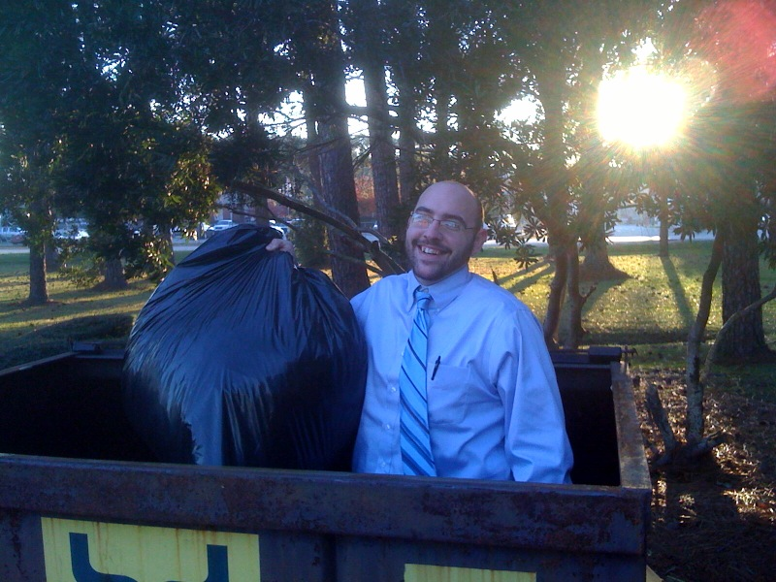
One Man’s Trash…
Dumpster diving is the act of sorting through garbage to find documents and information that has been improperly discarded
Customer information
Internal records
Applications
Some things we’ve found:
Credit cards
Technical documentation
Backup tapes
Loan applications
Floor plans/schematics
Copies of identification
Lots of banana peels and coffee cups

Slide 24
Physical Threats: Protect Yourself
Never share your keys, passwords, or access tokens with others. This includes co-workers or other employees!
Never prop the door open or allow strangers inside the building
Ask them if they would politely check in with the front desk, then escort the visitor
Destroy all confidential paper data
Place in provided shred bins for disposal
Shred it yourself if you have access to a personal shredder
Cross-cut only – Straight-cut is easy to re-assemble
Secure all confidential information when you are not around
Lock information in filing cabinets
Clean desk policy
Always lock your workstation when you step away
This prevents others from accessing your resources
Report suspicious activity or persons immediately

Slide 25
Your Workstation
Access to a personal computer allows you to complete work more efficiently
Email
Word processing software
Online resources
Someone with access to your workstation now has access to your resources:
Databases
Customer records
Personal data
Email
Lock your workstation when you leave – even if you will be gone briefly!
Critical Data can be stolen in a matter of seconds
Windows Key + L : lock your computer
This will prevent somebody from “volunteering” you for the lunch tab tomorrow!

Slide 26

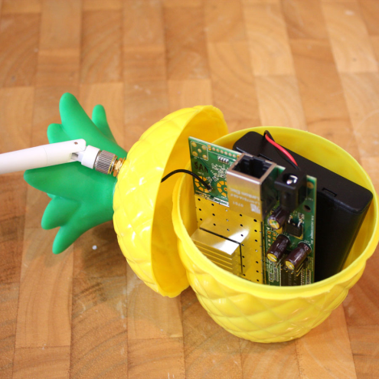
Wireless
Common Attacks
WEP Cracking
Sniffing
Fake Access Points
Beware of the WiFi Pineapple!
Best Practices
WPA/WPA2
VPN

Slide 27
Social Networking
Sites that allow users to post profiles, pictures and group together by similar interests
MySpace
Facebook
Livejournal
Some sites “enforce” age limitations, but no verification process exists to determine a user’s actual age
This means there are no barriers in place to prevent children from registering
Often lists personal details like name, age, location, pictures or place of business
Photos entice stalkers
Don’t list personal details on public websites
Popular with teenagers and young adults
False sense of anonymity – anyone can access this information
College admissions offices and employers are now utilizing social networking websites to perform background checks
Notes:
Mention JuicyCampus.com

Slide 28
Cyber Bullying
Harassment occurring through electronic means, such as email, chat rooms, forums, and blogs
Usually with the intent to cause emotional distress
Vulgar language
Racist comments
Threats
Consequences are as extreme as murder and suicide
Education is only real solution
Take 5
Trusted person
Report it – silence is unacceptable

Slide 29
Portable Devices
Easy to lose, easy to steal
Always keep them within sight, or lock away when not in use
Use caution when in crowded areas
PacSafe bags are cost-effective, great ways to secure your mobile computing devices
http://www.pacsafe.com
Report lost or stolen items immediately
Sometimes carry confidential information
Use strong passwords!
Require the device to lock after a period of inactivity
Use encryption
TrueCrypt: http://www.truecrypt.org
Always cleanly wipe portable devices before disposal
Eraser: http://www.heidi.ie/eraser/
Usually very valuable – you don’t want to pay for a new one!
As expensive as devices these devices are, the information on them is often worth much more.
Your daughter’s piano recital pictures, your tax returns or bank statements, or that dissertation or thesis you’ve been working on for a year!
Notes:
Never to plug in any portable devices with approval from IS director.

Slide 30
Personal Protection
Always use antivirus, anti-spyware, and firewall
Educate your family on the dangers of the Internet
Stalkers, sexual predators, crooks and con-men have access to computers too
Be selective in the sites you visit
Some downloads have Adware or Spyware bundled with the file
Monitor children’s internet usage
Encrypt stored data and dispose of data properly

Slide 31
Top Ten Tips
Never write down or share your passwords
Don’t click on links or open attachments in email
Use antivirus, anti-spyware, and firewall and don’t disable
Don’t send sensitive data over unencrypted channels
Dispose of data properly
Cross-cut shredding
Multiple-wipe or physically destroy hard drives

Slide 32
Top Ten Tips
Don’t run programs from un-trusted sources
Lock your machine if you step away
Properly secure information
Safes, locked drawers for physical documents
Encryption for digital information
Verify correct person, website, etc.
If something seems too good to be true, it probably is

Slide 33
Victim of Identity Theft?
Place a fraud alert on your credit reports
Close the accounts you know or believe to have been compromised
File a complaint with the Federal Trade Commission
File a report with your local police
For more information, visit the FTC’s website:
http://www.ftc.gov/bcp/edu/microsites/idtheft/index.html

Slide 34
Privacy Issues
GLBA
http://www.ftc.gov/privacy/privacyinitiatives/glbact.html/
FFIEC
http://www.ffiec.gov/
HIPAA
http://www.hhs.gov/ocr/hipaa/
Sarbanes-Oxley
http://www.pcaobus.org/
FDIC
http://www.fdic.gov/

Slide 35

Further Education
Microsoft:
http://www.microsoft.com/protect/fraud/default.aspx
CERT:
http://www.cert.org/tech_tips/home_networks.html
McAfee:
http://home.mcafee.com/AdviceCenter/Default.aspx
US CERT:
http://www.us-cert.gov/cas/tips/
Trace Security
http://tracesecurity.com (videos on lower-right)
Wikipedia and Google
Research is fun!

Slide 36
Alerts and Advisories
US CERT:
http://www.us-cert.gov/
Microsoft:
http://www.microsoft.com/security/
Security Focus:
http://www.securityfocus.com/
PayPal, your bank, and other popular websites will typically address scams or security problems on their home page

Slide 37
Thank you
For your attention!

